Slide 1
Discovering symbolic models from deep learning with inductive biases – reproduction
Vishal Jain
Oral Presentation
Notes:
What is the goal of this talk? Get people interested in the domain and wanting to learn more Motivate some kind of the following: problem is worthwhile, hard and this power point solves it.

Slide 2
Prelude…
Discovering symbolic models from deep learning with inductive biases.
Notes:
Break down title -> what are we talking about here discovering symbolic models
Eg symbolic model
From deep learning
NN with more than 1 hidden layer
With inductive biases – choosing the architecture sensibly, so image -> cnn, text / sequence -> transformers,

Slide 3
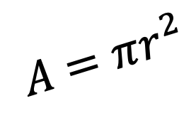
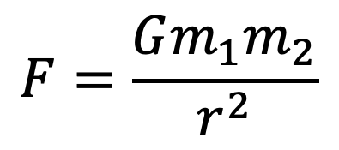
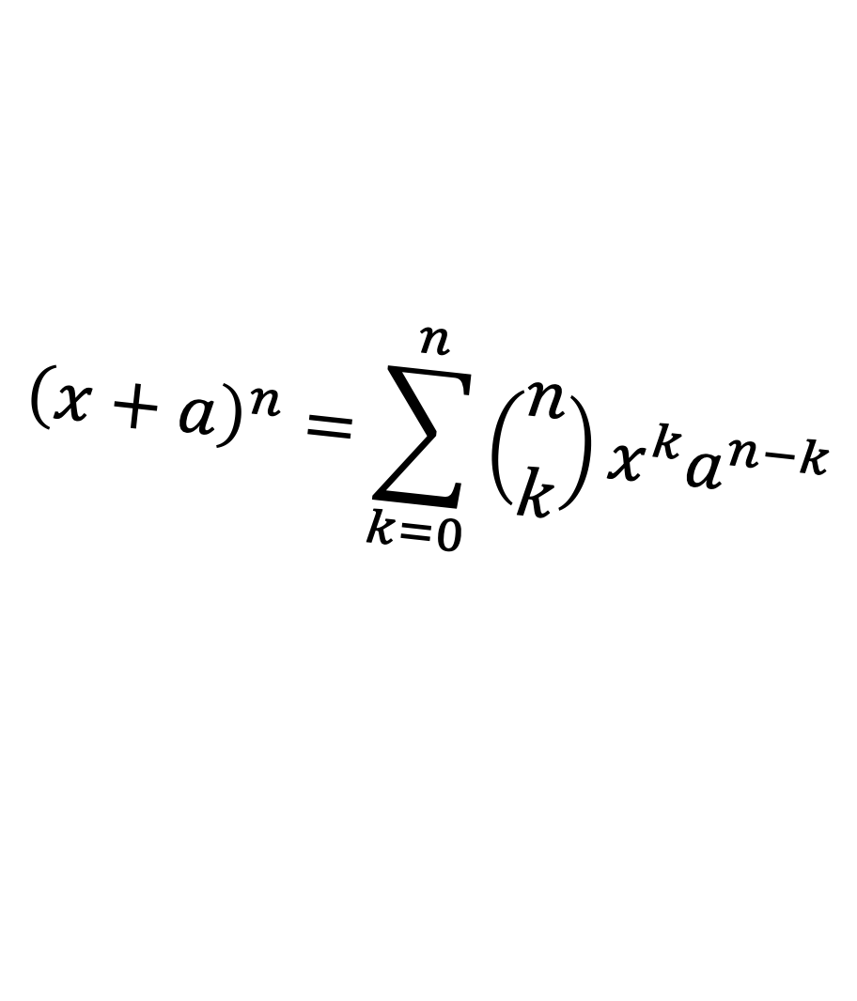
Prelude…
Discovering symbolic models from deep learning with inductive biases.
$$A=πr^{2}$$
$${\left(x+a\right)}^{n}=\sum_{k=0}^{n}{\left({n \atop k}\right)x^{k}a^{n−k}}$$
$$F=\frac{Gm_{1}m_{2}}{r^{2}}$$
Notes:
Break down title -> what are we talking about here discovering symbolic models
Eg symbolic model
From deep learning
NN with more than 1 hidden layer
With inductive biases – choosing the architecture sensibly, so image -> cnn, text / sequence -> transformers,

Slide 4
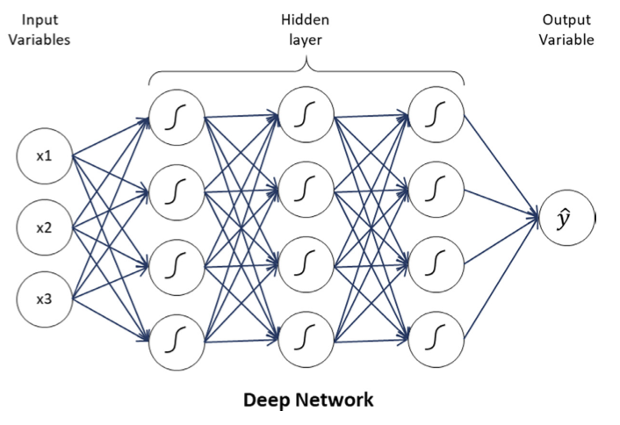
Prelude…
Discovering symbolic models from deep learning with inductive biases.
Notes:
Break down title -> what are we talking about here discovering symbolic models
Eg symbolic model
From deep learning
NN with more than 1 hidden layer
With inductive biases – choosing the architecture sensibly, so image -> cnn, text / sequence -> transformers,

Slide 5

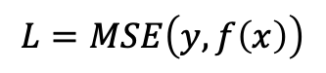
Prelude…
Discovering symbolic models from deep learning with inductive biases.
$$L=MSE\left(y,f\left(x\right)\right)$$
Notes:
Break down title -> what are we talking about here discovering symbolic models
Eg symbolic model
From deep learning
NN with more than 1 hidden layer
With inductive biases – choosing the architecture sensibly, so image -> cnn, text / sequence -> transformers,

Slide 6
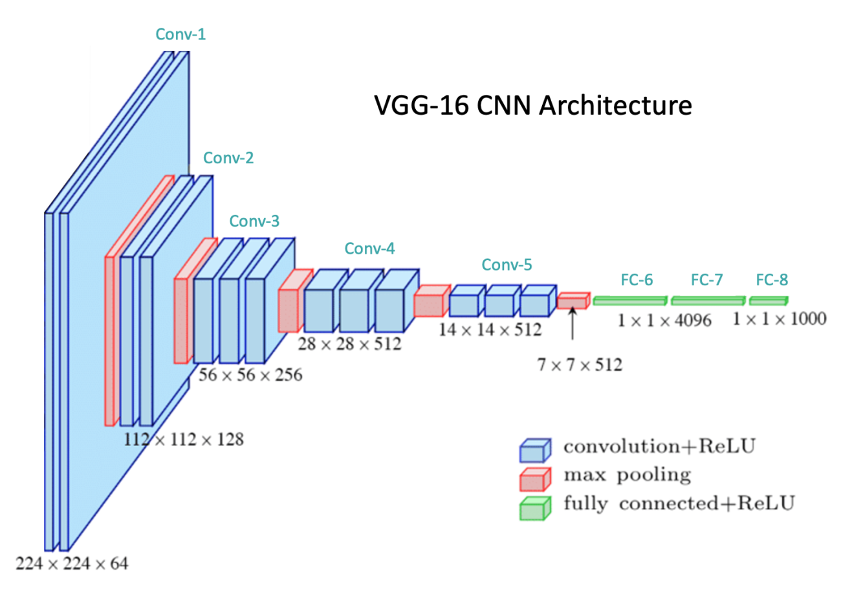
Prelude…
Discovering symbolic models from deep learning with inductive biases.
$$L=MSE\left(y,f\left(x\right)\right)$$
Notes:
Break down title -> what are we talking about here discovering symbolic models
Eg symbolic model
From deep learning
NN with more than 1 hidden layer
With inductive biases – choosing the architecture sensibly, so image -> cnn, text / sequence -> transformers,

Slide 7
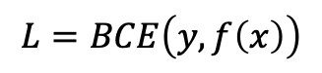
Prelude…
Discovering symbolic models from deep learning with inductive biases.
$$L=BCE\left(y,f\left(x\right)\right)$$
Notes:
Explain why the CNN and BCE loss provide better inductive biases
Follow through on UDL to check that this checks out.

Slide 8
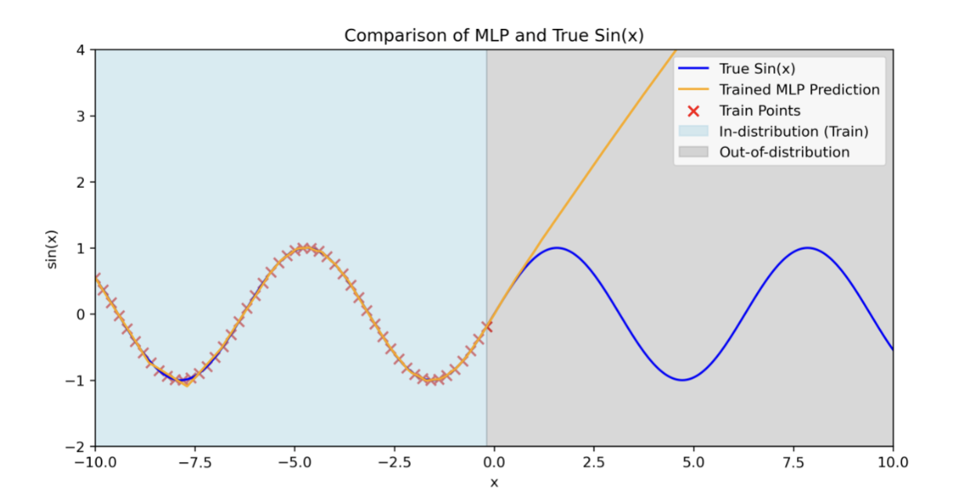
Motivation
Notes:
Why do we even want symbolic models, why not just train these NNs

Slide 9
Symbolic distillation framework
Design a neural network with a separable internal structure and suitable inductive bias.
Train the model and encourage learning a low-dimensional representation.
Replace a learned component with a symbolic model.
Retrain model and repeat until all components are replaced.
Notes:
How are we going to do tackle

Slide 10
Scope
Rediscovering Hamiltonians
Rediscovering Force Laws
Discovering a new equation for a real-world cosmology
problem
Notes:
Original papers findings, scope of this.

Slide 11

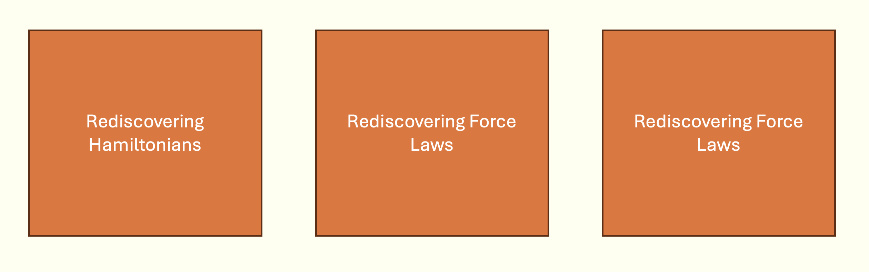
Scope
Notes:
Original papers findings, scope of this.

Slide 12
Outline
Background
Data
Model
Training
Symbolic distillation
Evaluation
Results
Conclusion

Slide 13
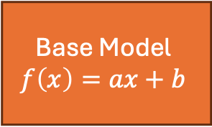
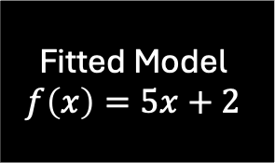
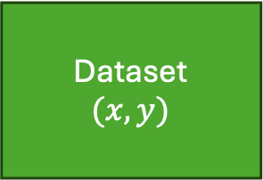
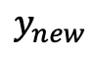
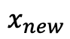
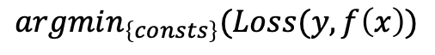
Background pt 1 – Symbolic regression
User specified
Dataset
$$(x,y)$$
$$argmin_{\left\{consts\right\}}(Loss(y,f\left(x\right))$$
Fitted Model
$$f\left(x\right)=5x+2$$
$$y_{new}$$
Base Model
$$f\left(x\right)=ax+b$$
via grad descent
Loss
$$x_{new}$$

Slide 14
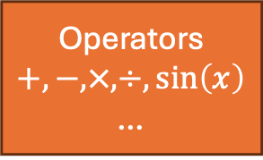
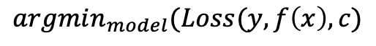
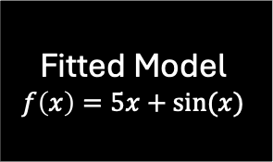
Background pt 1 – Symbolic regression
User specified
Dataset
$$(x,y)$$
$$argmin_{model}(Loss(y,f\left(x\right), c)$$
Fitted Model
$$f\left(x\right)=5x+sin⁡(x)$$
Operators
$$+, −, ×, ÷,\sin\left(x\right)$$
…
$$y_{new}$$
Base Model
$$f\left(x\right)=ax+b$$
via genetic algorithm
Loss
$$x_{new}$$

Slide 15

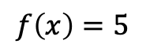


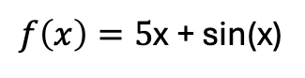
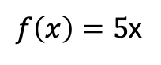
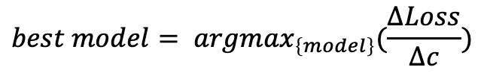
Background pt 1 – Symbolic regression
Solutions
Loss
Complexity
$$f\left(x\right)=5$$
100
1
$$×$$
$f\left(x\right)=5$x
80
2
$$×$$
$f\left(x\right)=5$x + sin(x)
20
3
Loss
Sharpest drop
$$×$$
Complexity
$$best model= argmax_{\left\{model\right\}}(\frac{ΔLoss}{Δc})$$

Slide 16
Background pt 2 – Graph Neural Networks
Notes:
Gnns walk through model
Nodes
Edges

Slide 17
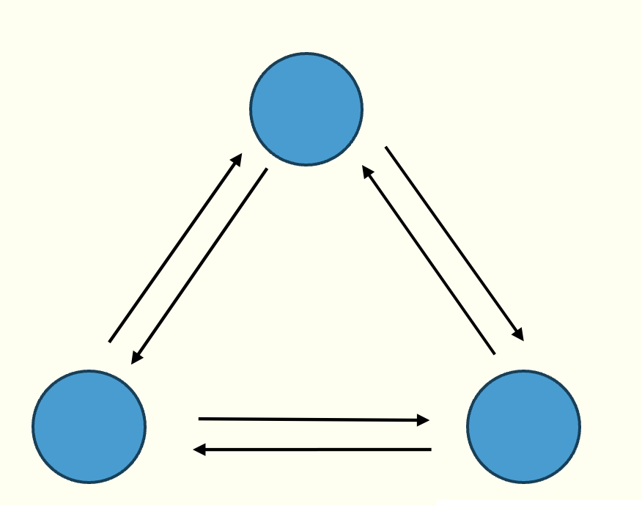
Background pt 2 – Graph Neural Networks
Notes:
Linear regression -> symbolic regression conceptual black box
How it works briefly

Slide 18
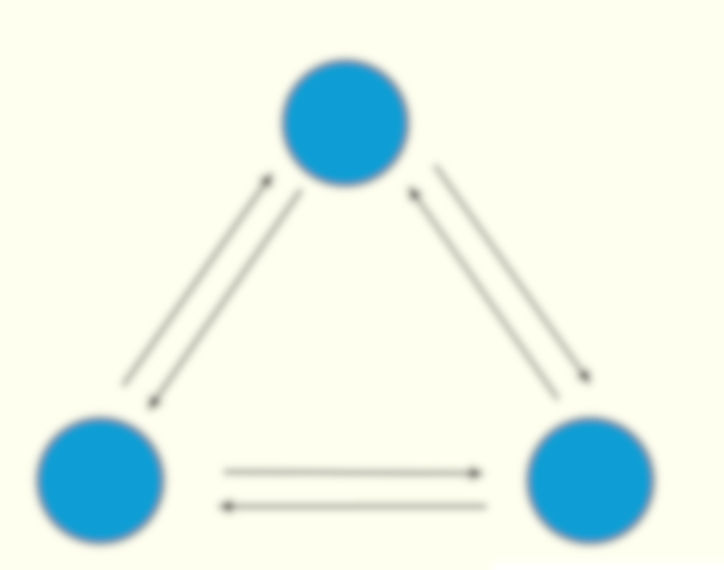
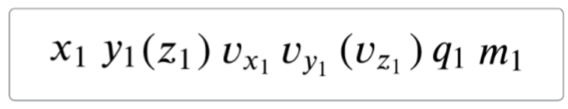

Background pt 2 – Graph Neural Networks
$$X_{1}$$
T
Notes:
Linear regression -> symbolic regression conceptual black box
How it works briefly

Slide 19
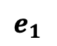
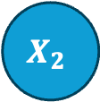
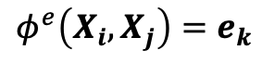
Background pt 2 – Graph Neural Networks
$$X_{2}$$
$$e_{1}$$
$$X_{1}$$
$$φ^{e}\left(X_{i}, X_{j}\right)=e_{k}$$
Notes:
Linear regression -> symbolic regression conceptual black box
How it works briefly

Slide 20
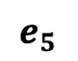
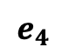
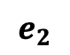
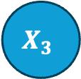
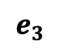
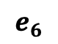
Background pt 2 – Graph Neural Networks
$$X_{2}$$
$$e_{4}$$
$$e_{1}$$
$$e_{5}$$
$$e_{3}$$
$$X_{3}$$
$$e_{2}$$
$$X_{1}$$
$$e_{6}$$
$$φ^{e}\left(X_{i}, X_{j}\right)=e_{k}$$
Notes:
Edge message aggregation and node model.

Slide 21
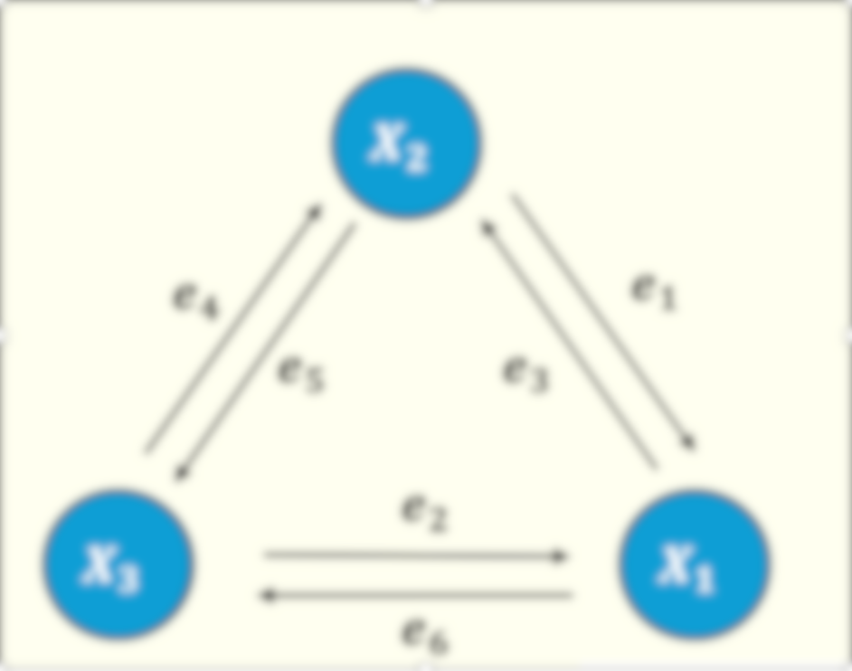
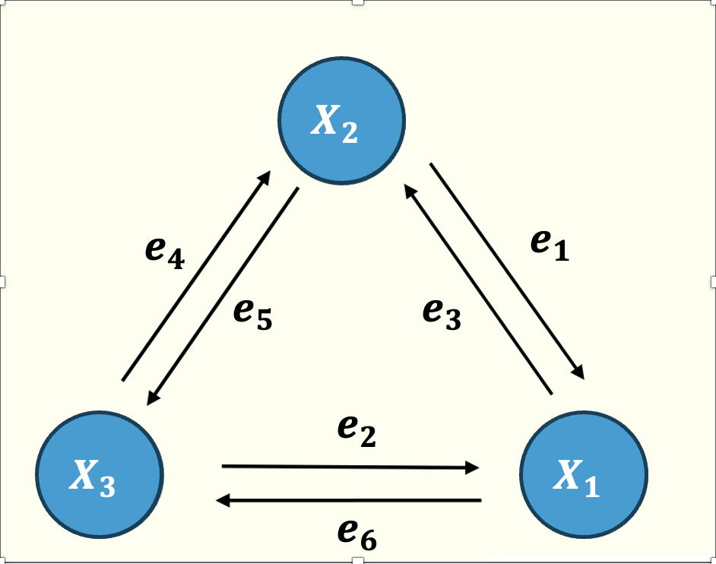
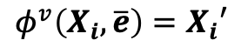
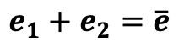
Background pt 2 – Graph Neural Networks
$$e_{1}+e_{2}=\overline{e}$$
$$φ^{v}\left(X_{i}, \overline{e}\right)=X_{i}′$$
Notes:
Edge message aggregation and node model.

Slide 22
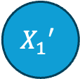
Background pt 2 – Graph Neural Networks
$$X_{1}′$$
$$e_{1}+e_{2}=\overline{e}$$
$$φ^{v}\left(X_{i}, \overline{e}\right)=X_{i}′$$
Notes:
Edge message aggregation and node model.

Slide 23
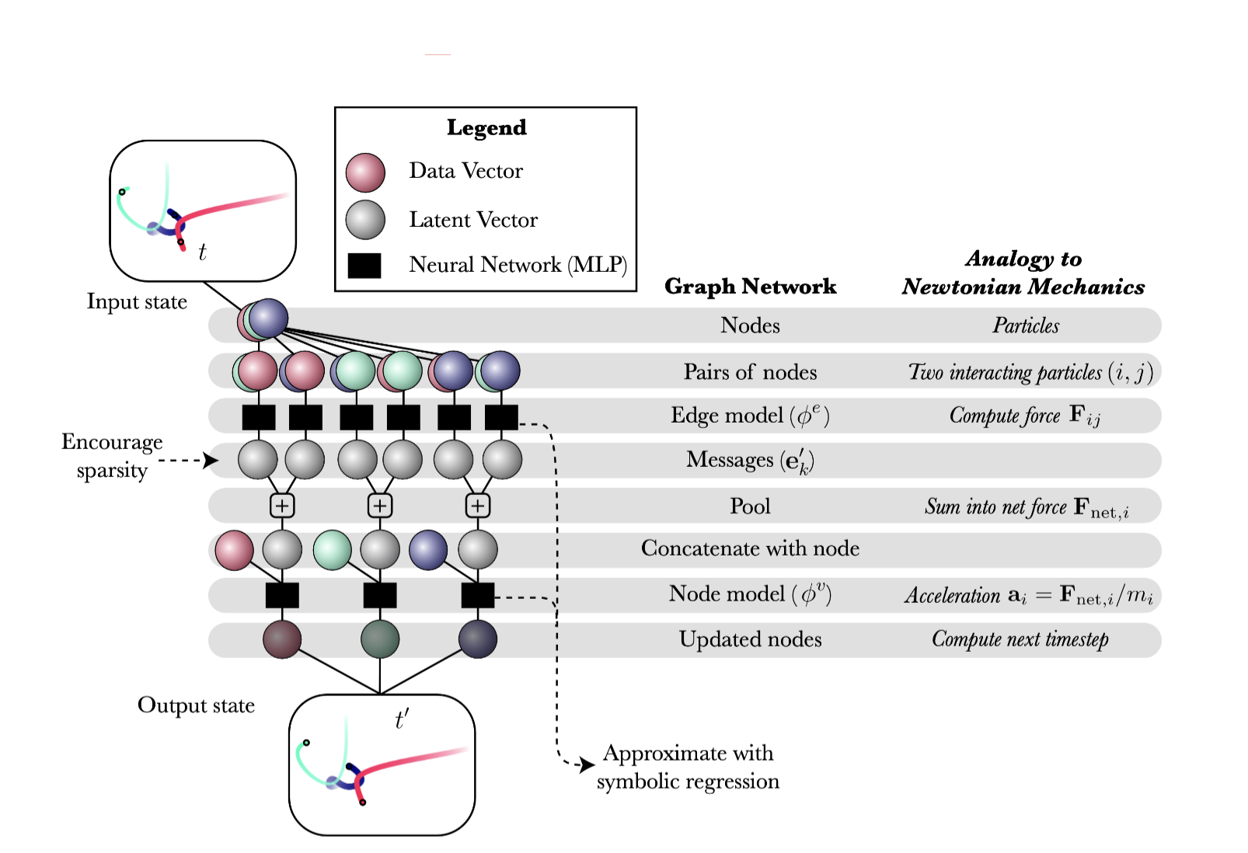
Overview
Notes:
Tie it all back together
+ Why the GNN is good – permutation invariant – seperable internal components, summation of edge message an appropriate inductive bias to use

Slide 24
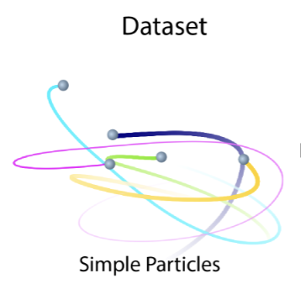
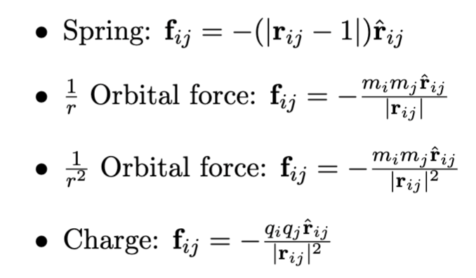
Data
X.shape = 10000 x 500 x 4 (8) x 6 (8)
Y.shape = 10000 x 500 x 4 (8) x 2 (3)
No. Sims
Time steps
Bodies
Features / accelerations
Notes:
Force laws
Explain in a bit more detail what the input looks like – how it was generated – using the original code.
Dataset: what was generated, how it was generated,
Interacting particles, simulated under a variety of force laws
Initial position drawn from a standard normal dist + mass from a log normal dist + charge randomly -1, 1

Slide 25
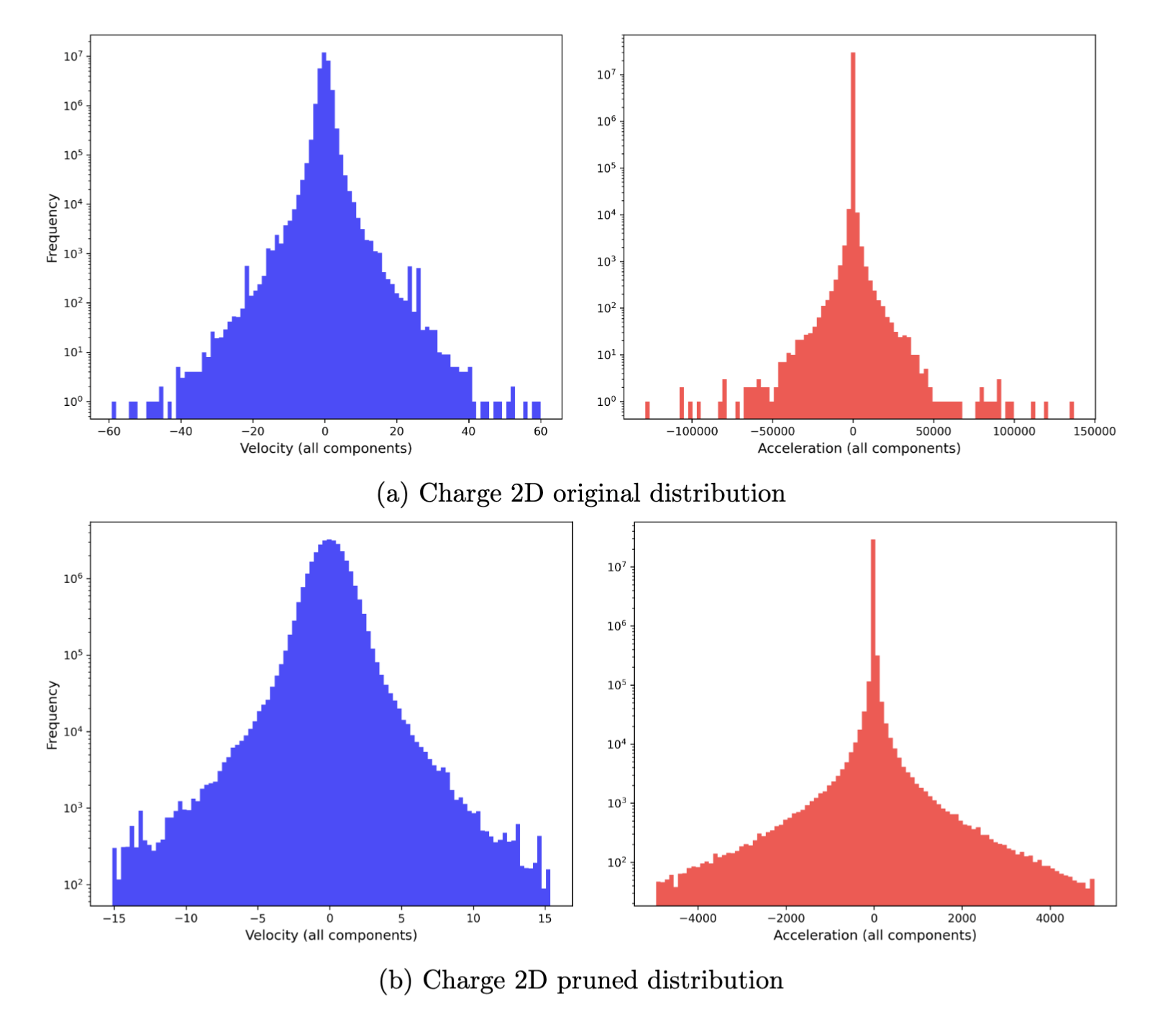
Dataset pruning
1) Compute the 0.01st and 99.99th percentile values for velocity and acceleration across all components.
2) Remove time steps that contains a body with a velocity or acceleration in any component outside these identified limits.
Notes:
Dataset
What was the need, what was the steps, what was the effect, why it is a sensible thing to do.

Slide 26
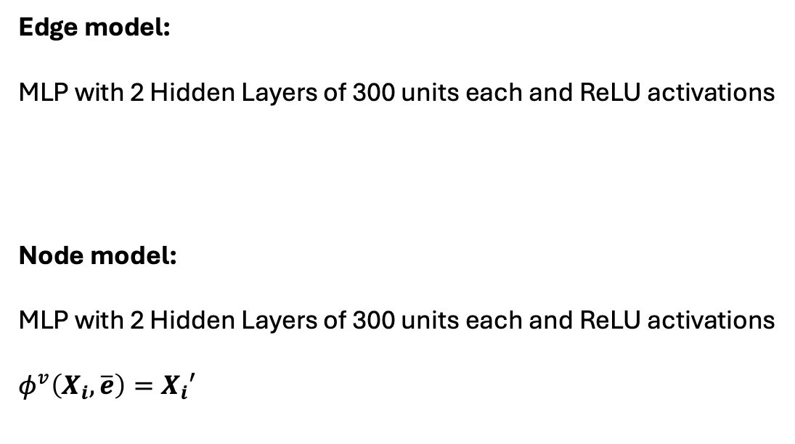
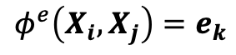
Model architecture
Edge model:
MLP with 2 Hidden Layers of 300 units each and ReLU activations
Node model:
MLP with 2 Hidden Layers of 300 units each and ReLU activations
$$φ^{v}\left(X_{i}, \overline{e}\right)=X_{i}′$$
$$φ^{e}\left(X_{i}, X_{j}\right)=e_{k}$$
Notes:
Describe the model architecture : edge and node models

Slide 27
Training strategies
Standard Strategy:
The standard training strategy is the baseline, edge message dimensionality 100. Loss is the MAE between the predicted and true accelerations.
Bottleneck Strategy:
Standard + changes dimensionality of the edge message to the dimensionality of the problem (2 or 3).
L1 Strategy:
Standard + adds average L1 norm of the edge messages to the loss, weight of regularisation term set to 1.0 × 10−2.
KL Strategy:
Samples edge messages from a multivariate normal distribution defined by edge model which now outputs a 200-dimensional vector.
First 100 comps represent the mean and rest represent the log variance. Adds the average Kullback-Leibler divergence penalty over all edge messages, using a standard normal prior to the loss.
Notes:
Describe the 4 training strategies

Slide 28
Model Training
Trained over 100 epochs using the Adam optimizer with an initial learning rate of 0.001 and weight decay set to 1.0 × 10−8.
The learning rate is modulated according to the 1cycle learning rate policy, which increases the learning rate to a peak of 0.001 before gradually decreasing it by a factor of 100-000.
Random translation is used as a form of data augmentation to improve the model’s generalisation capabilities.
Trained on a single NVIDIA A100 GPU.
Notes:
Describe the hyper parameters epochs and differences in training between this work and the original

Slide 29
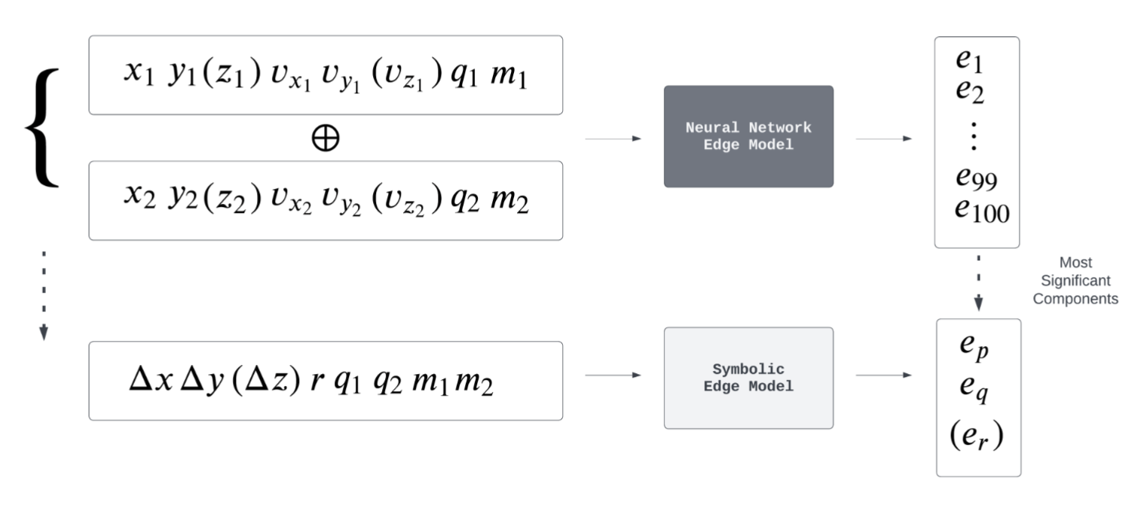
Model Distillation : Edge Model
Notes:
Talk through the plot, again cmment on differences in the symbolic search used here vs in the paper – pysr vs eureka, not using all the operators…

Slide 30
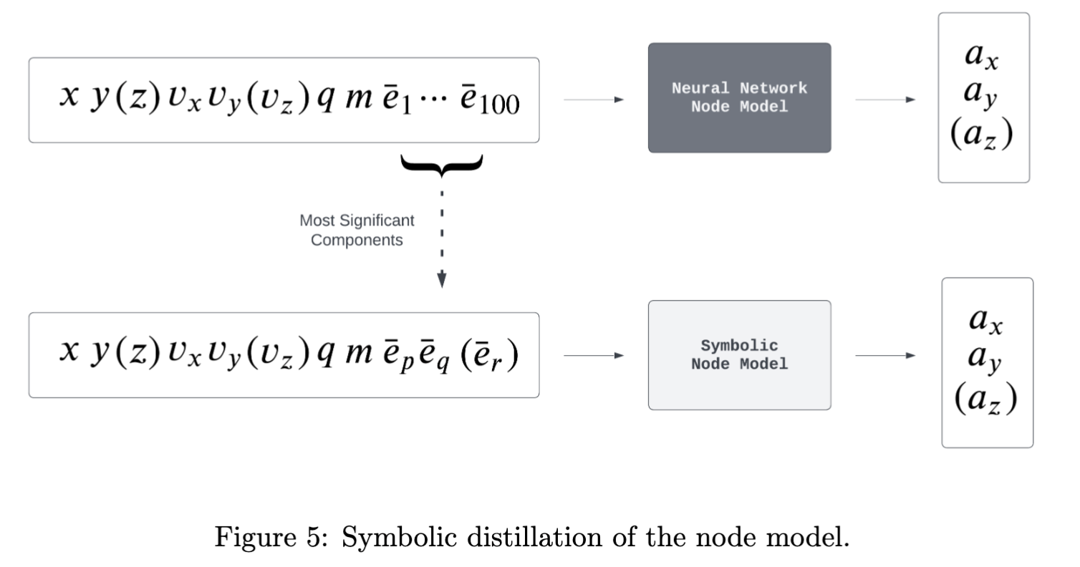
Model Distillation : Node Model
Notes:
Talk through the plot

Slide 31
Evaluation criteria
Average test set MAE – predictive capabilities
R^2 statistic between significant edge message components and linear transform of force / accel – Quality of learned representation
Fraction of total standard deviation contained in the top d message components – Message sparsity
Symbolically regress the edge and node models - verify physical expressions can be retrieved.
Compare symbolic model’s average test set MAE with NNs’ – Compare generalisability.
Notes:
Introduce what will be shown for results
Mae
R2 (!?)
Sparsity
Symbolic reconstruction

Slide 32
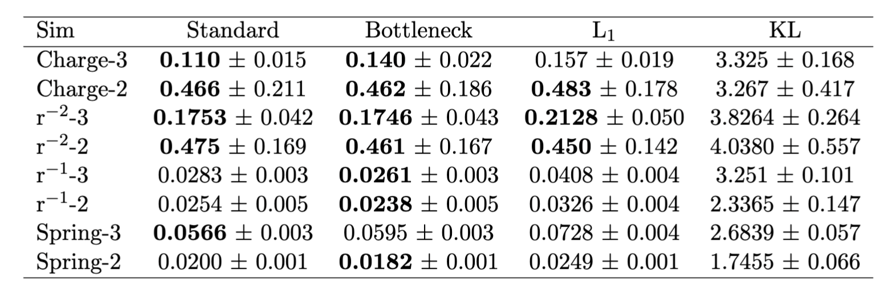
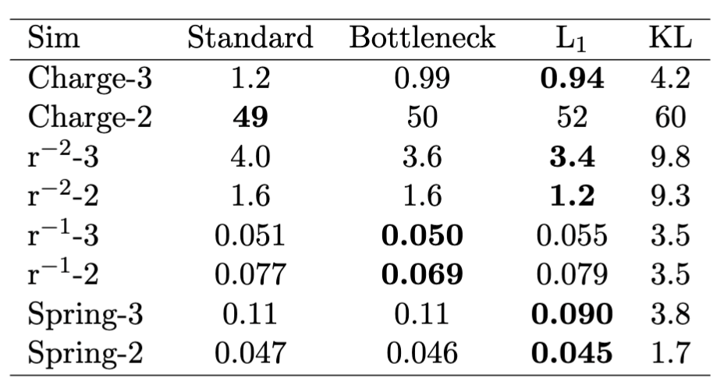
Results: MAE
Reproduced
Original
Notes:
Compare original MAE and reproduced
All results are much lower
Both find L1 to be the worst
Both find standard bottleneck and L1 to be very similar
Generally the 2d r1 r2 and charge perform worse and spring 3 -> r dependancies, variance arg

Slide 33
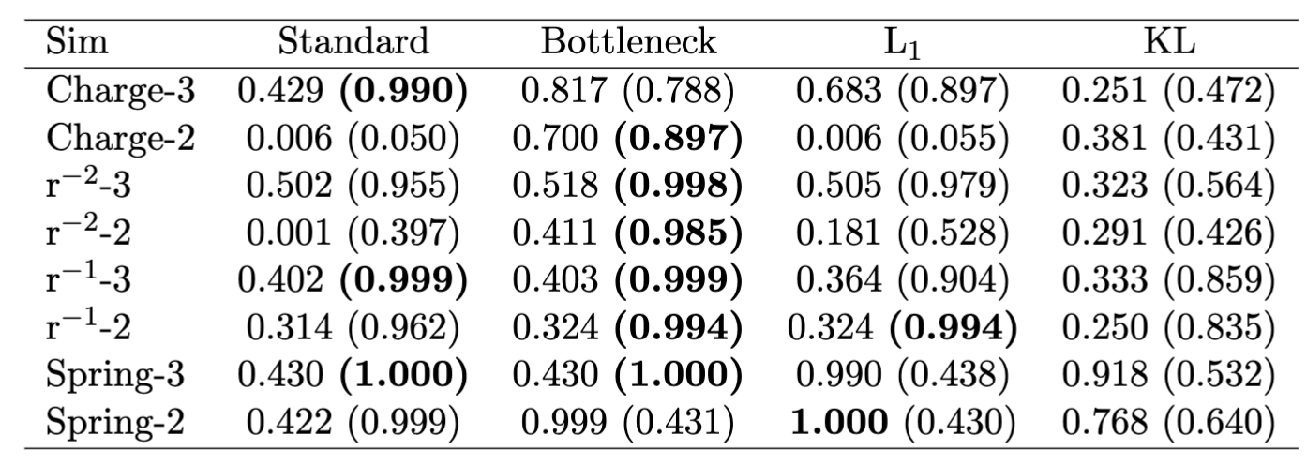

Results: R2
Reproduced
Original
Notes:
Compare original R2 and reproduced

Slide 34


Results: R2 aside
Notes:
Go over acceleration vs true force

Slide 35

Results: Sparsity
Notes:
Sparsity results
KL -> L1 -> standard

Slide 36


Results: Symbolic reconstructions examples
Edge model reconstructions
Node model reconstructions
Notes:
Symbolic reconstructions good and bad examples

Slide 37

Results: Symbolic reconstructions
Notes:
Symbolic reconstruction table

Slide 38

Results: Symbolic model vs NN model
Notes:
Explain that only models where all node and edge componetns could be symbolically reconstruced were investigated

Slide 39
Conclusions and Future work
Agreements:
+ General trends in test set MAE shared
+ Able to recover pairwise force for many of the same experiments via symbolic distillation
Differences:
- Not able to show symbolic model generalised better than NN
- Standard training strategy found sufficient to recover pairwise force for many experiments.
Future work:
Add additional inductive biases eg Newtons 3rd Law, random rotation data augmentation etc. See if symbolic distillation more likely to succeed on challenging cases.
Repeat analysis with different random seeds and compare.
Notes:
Compare

